Slide 1
National Data Opt-out
Compliance Implementation Team
Presented by
Sara Buck

Slide 2
Agenda
Setting service
National data opt-out policy summary
Check for National Data Opt-outs service
Compliance resources
Further information
Information correct as of July 2019

Slide 3
The setting service - www.nhs.uk/your-nhs-data-matters
How the public make their choice

Slide 4
Background
Better use of information and data has the potential to transform health and care for everyone
People want to know that their privacy and rights are safeguarded, understand how and when information about them is shared, and, be able to make an informed choice about whether to share their data or not
It was in this context that the former Secretary of State for Health commissioned a review on data security and data sharing in the health and social care system by Dame Fiona Caldicott, the National Data Guardian for Health and Care (NDG). This was published in July 2016 followed by the Government Response to the review in July 2017
The work takes place in the context of the drive to develop a digitised health and care system that offers patients more control and choice over the care they receive, improves their experience, provides them with better outcomes and delivers a more efficient health and care system
Information correct as of July 2019

Slide 5
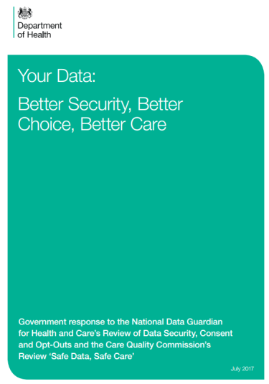
NDG Review and Government’s response
National Data Guardian Review – Key Points:
You are protected by the law
Information is essential for high quality care
Information is essential for other beneficial purposes
You have the right to opt out of your personal confidential information being used for these other purposes beyond your direct care:
Providing local services and running the NHS and social care
Supporting research and improving treatment and care
This opt-out will be respected by all organisations that use health and care information
Explicit consent will continue
The opt-out will not apply to anonymised information
Arrangements will continue to cover exceptional circumstances
The Government response to the National Data Guardian Review supported the recommendations
Information correct as of July 2019

Slide 6
National data opt-out setting service
The service to set a national data opt-out was made available on 25 May 2018
Public can access the service online here: www.nhs.uk/your-nhs-data-matters
A national telephone service is also available to support an assisted digital, and a non-digital (print-and-post) service
Public have access to information to make an informed choice about whether to share their data for reasons other than their individual care
Service can also be accessed via the NHS App using NHS Login as the authentication
Information correct as of July 2019
Notes:
Other points to note:
Anyone registered on PDS (i.e. with data in English system) can set a national data opt-out, and people resident in Wales, Scotland etc. who have received care in NHS in England and have an English or Welsh NHS number. The policy is clear that patients cannot opt-out of their registration data being shared e.g. the opt-out does not prevent data being recorded on PDS.
Young people can set their own opt-out from age 13 - aligns with the Data Protection Act 2018 which sets 13 as the minimum age at which young people can give their consent to participate in digital services.
Formal proxies can set opt-out on behalf of others – those with parental responsibility for <13s, a lasting power of attorney (both health and welfare and property and financial affairs) or a court appointed deputy

Slide 7
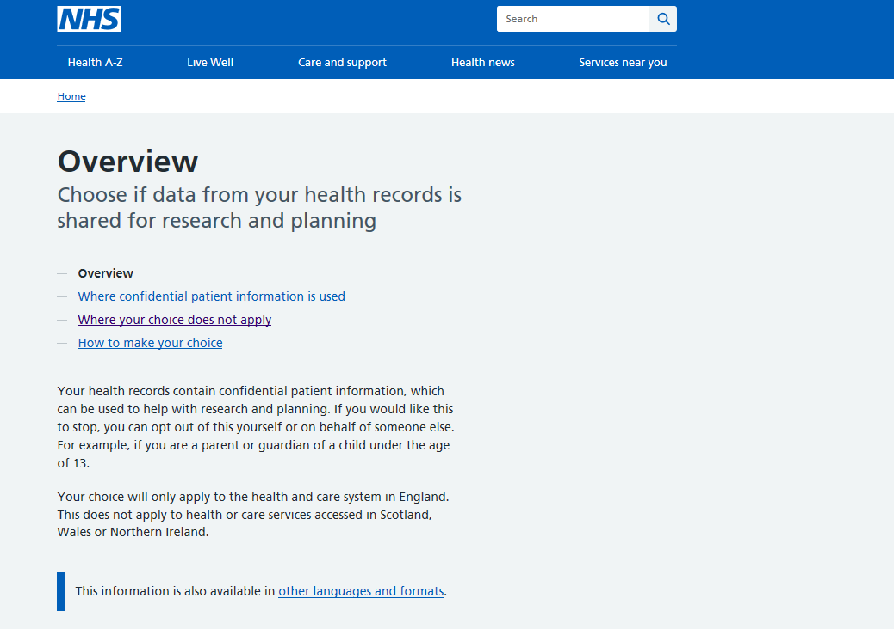
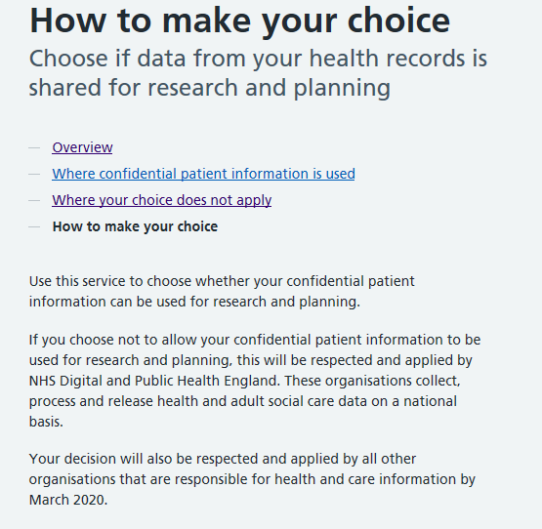
Notes:
Visual of the landing page and how to manage your choice

Slide 8
Informing the public

National press: 24.8m circulation, 53.2m reach
National and regional radio: 36.58m circulation
·
Posters and materials in GP practices, hospitals, pharmacies and NHS dentists

Letter to type 2 patients
nhs.uk
Find out why your data matters web site

Accessible materials inc. BSL video, Easy Read, braille, and 11 languages
65% of people say they have high trust and confidence in the NHS/their local GP storing and using their personal information, up 5% points from 2017¹
1. Information Commissioner’s Office: Information Rights Strategic Plan (August 2018)

Slide 9
Your patients
Please ensure you:
Display the ‘Your Data Matters to the NHS’ poster, and make handouts available to patients
Review existing patient materials (posters, leaflet, website) and remove any that are out of date so that patients have the latest information about data uses beyond individual care and the national data opt-out
Check locally produced materials for accuracy if they refer to opting out, such as registration forms, questionnaires
Consider using the screen text for electronic displays in reception/waiting areas
Consider using the recommended standard text about the wider uses of health and care data, alongside or within Privacy Notices
All resources are available at: https://digital.nhs.uk/national-data-opt-out
Information correct as of July 2019
Notes:
These slides are hidden and only to be used when talking to new organisations and need to push awareness messages as well as compliance

Slide 10
Your workforce
Please ensure:
Your Information Governance lead, Caldicott Guardian, Data Protection Officer are aware of the national data opt-out
Your organisation has policies and procedures in place for handling enquiries about data use and opt-outs, which includes the national data opt-out
Clinicians and staff who deal with patients understand your policy and procedures for enquiries about data use and are aware of the national data opt-out
Clinicians and staff know to direct patients who ask for further information to the handouts, the NHS website at www.nhs.uk/your-nhs-data-matters or the telephone helpline (telephone number is in the handouts and on the website)
Materials for workforce and specialists needing more detail are available at: https://digital.nhs.uk/services/national-data-opt-out-programme/guidance-for-health-and-care-staff
Information correct as of July 2019
Notes:
These slides are hidden and only to be used when talking to new organisations and need to push awareness messages as well as compliance

Slide 11
Policy summary
When does the national data opt-out apply

Slide 12
When does the national data opt-out apply?
Applies to data shared for planning and research purposes
Data shared for an individual’s care and treatment
Legal requirement / public interest / consent
Data is anonymised
Single option that covers: Research – finding ways to improve treatments and identify causes of and cures for illnesses
Planning – to improve and enable the efficient and safe provision of health and care services
E.g. where data is shared between the health and care professionals in a hospital and in a GP practice
E.g. There is a mandatory legal requirement such as a court order, to protect the greater interests of the general public, or there is explicit consent
The data shared is determined to be compliant with the ICO Anonymisation: managing data protection risk code of practice
This identifies you personally
This identifies you personally
This identifies you personally
This does not identify you personally
Notes:
The national data opt-out applies only where confidential patient information is being shared for purposes beyond an individual’s care and treatment e.g. it is intended to be used in research studies or to help in managing the efficient and safe running of the health and care system
Single question: In case asked, actual question is:
Your confidential patient information can be used for improving health, care and services, including:
• planning to improve health and care services
• research to find a cure for serious illnesses
I allow my data to be used for research and planning: Yes/No
Regardless of the national data opt-out confidential patient information must not be used for insurance or marketing purposes without the explicit consent of the patient
The national data opt-out is for purposes beyond an individual’s care and treatment, not their individual care (aka direct care)
The national data opt-out will NOT apply where:
Mandatory legal requirement such as:
CQC has statutory powers to require information for their inspection purposes
Reporting of notifiable diseases
Reporting of gunshot wounds
NHS Digital require a health and care organisation to provide data under s259 of HSCA 2012 (i.e. NHSD are directed / requested to collect the data and have issued a Data Provision Notice to providers to mandate the provision of that data such as National Diabetes Audit, Community Services Dataset & GP Appointments Data)
NHS Counter fraud service
Other legal gateways e.g. Crime and Courts Act, Security Services Act etc
Positive public interest test – (this would include communicable diseases PHE controlled regulation 3). Data controllers expected to undertake their own public interest test. This should look at the individual circumstances of the case, examples of disclosures that may be made in the public interest are reporting gunshot wounds and knife wounds or reporting patient fitness to drive to DVLA.
Consent – eg explicit consent for a specific research study or clinical trial
Opt-out does NOT apply to data anonymised in line with the ICO CoP – note the CoP is being reviewed following introduction of GDPR. This currently covers a range of data from anonymous through to data which are de-identified for limited access with a wider suite of controls.

Slide 13
Summary of opt-out policy
Responsibility for the application is on data controllers (including joint), and data processors acting under the instruction of data controllersType of data – Confidential Patient Information
Covers health and adult social care in England only
Applies to publicly funded or co-ordinated care
Purpose and legal basis underpins application of opt-out:
Applies if data use/disclosure is for purposes beyond individual care; and
Data is being released under section 251 (reg 2 or 5) NHS Act 2006 (to meet Common Law Duty of Confidentiality)
Unless specific exemption
Full operational policy guidance at: https://digital.nhs.uk/national-data-opt-out
Information correct as of July 2019
13
Notes:
Beyond individual care: Individual care defined by NDG in review: - includes assurance of safe and high quality care and treatment through local audit, management of untoward incidents, outcomes measurement etc, if carried out by professionals/team with legit relationship, providing care. (see Operational Policy Guidance)
Main consideration is how Common Law Duty of Confidentiality is met – if relying on s251 then opt-out will most likely apply.
s251 - authorisation given under :
regulation 2 (medical purposes related to the diagnosis or treatment of neoplasia i.e. cancer); or
regulation 5 (general medical purposes including medical research)
of the Control of Patient Information Regulations 2002 under the NHS Act 2006 Section 251
The Confidentiality Advisory Group which provides independent expert advice on applications for data use under Section 251 can in some cases agree that opt-outs do not apply but have indicated that this would only be in exceptional circumstances
Confidential Patient Information is a legal term in use across the health and care system. It is defined in section 251 (10 & 11) of the National Health Service Act 2006, as:
“(10) In this section “patient information” means—
(a) information (however recorded) which relates to the physical or mental health or condition of an individual, to the diagnosis of his condition or to his care or treatment, and
(b) information (however recorded) which is to any extent derived, directly or indirectly, from such information,
whether or not the identity of the individual in question is ascertainable from the information.
(11) For the purposes of this section, patient information is “confidential patient information” where—
(a) the identity of the individual in question is ascertainable—
(i) from that information, or
(ii) from that information and other information which is in the possession of, or is likely to come into the possession of, the person processing that information, and
(b) that information was obtained or generated by a person who, in the circumstances, owed an obligation of confidence to that individual.”
Broadly it is information about either a living or deceased person that meets the following 3 requirements:
a) identifiable or likely identifiable e.g. from other data likely to be in the possession of the data recipient; and
b) given in circumstances where the individual is owed an obligation of confidence; and
c) conveys some information about the physical or mental health or condition of an individual, a diagnosis of their condition; and/or their care or treatment.
CPI cannot be defined by a specific data item (e.g. name or postcode) alone, as it needs to be considered more broadly to take into account the nature of the information and the circumstances of the disclosure. Section 251 has been updated to ensure that the definitions used expressly include local authority social care (i.e. care provided for, or arranged by, a local authority).

Slide 14
Exemptions
Communicable diseases and risks to public health i.e. Regulation 3 Control of Patient Information Regs 2002
Data flowing to ONS for statistical purposes
Flows to PHE for National Cancer Registration Service and National Congenital Anomalies and Rare Diseases Registration Services
Data for provision and oversight of national population screening programmes
National patient experience surveys (CPES and CQC)
‘Assuring Transformation’ data flows, until programme closure
Information correct as of July 2019
14
Notes:
Slide hidden but available to use if questions are asked about any exemptions or specific examples on the exemption lists.
Some specific uses and scenarios: (most covered in section 7 of operational policy guidance)
Communicable diseases/PH – (OPG 6.2)- regulation 3 of s251 – in public interest
ONS flows – opt-out will not apply for the purpose of producing national statistics. NDG review recognised importance of integrity of national stats.
Many currently have separate opt-out mechanisms:
NCRS etc – separate opt-out mechanism
National screening programmes (endorsed by UK national screening committee) – separate opt-out mechanism
National Patient Experience surveys – exemption for National Cancer Patient Experience Survey (CPES) and CQC NHS Patient Survey Programme – continue to operate separate opt-out.
‘Assuring Transformation’ (approved data collection related to care of people with learning disability/autism) separate opt-out mechanism

Slide 15
Practical considerations
Applies to electronic (structured and unstructured) and paper format
Continues to apply after a person has died
Whole record must be removed from data being used
NHS Number is the key to record removal
Opt-outs are applied at a point in time, not retrospectively
Records containing information about multiple individuals
Applies to cross border flows – unless otherwise exempt
Statistical publication available
Information correct as of July 2019
Notes:
Slide hidden but available to use if questions are asked about detail of applying opt-outs.
Stats can be found at: https://digital.nhs.uk/services/national-data-opt-out-programme/national-data-opt-out-numbers

Slide 16
Clinical audit – local / national
Opt-out will NOT apply to local clinical audits
Falls within the definition of individual care, as set out in the NDG review “It includes the assurance of safe and high-quality care and treatment through local audit…”
NDG review also set out that data can be used for local clinical audit under implied consent, when undertaken by a team or professional with a legitimate relationship for the patient’s care
Opt-out WILL apply to national clinical audits (unless covered by another exemption)
Information correct as of July 2019
16
Notes:
Slide hidden but available to use if questions are asked about audits.
Definition of individual care is in Operational Policy Guidance (OPG) p42

Slide 17
Payments, invoice validation and risk stratification
Payments and invoice validation
Anonymised data to be used wherever possible
Will NOT apply to non-contracted invoice validation
Will apply to purposes which rely on s251 support*
*other than approvals where CAG have waived the standard condition to apply opt-outs
Risk stratification
Will NOT apply to risk stratification for case finding, where carried out by a provider involved in an individual’s care (or data processor). This is to be treated as individual care for purposes of the opt-out
WILL apply to all data provided which relies on s251 support under CAG 7-04(a)/2013
Will NOT apply to data anonymised in line with the ICO code of practice on anonymisation, (i.e. this data does not rely on s251 support)
Information correct as of July 2019
17
Notes:
Spot contract same as non-contracted
Payments – wherever possible anonymised data should be used for payment/invoice validation.
*3 specific CAG approvals for invoice validation where opt-outs waived - OPG 7.1
Risk Strat OPG 7.2
GP system codes for Type1 should mean data does not leave the practice in the first place

Slide 18
Data Protection and confidentiality – a reminder
GDPR requires that processing of personal data is fair, lawful and transparent
To be lawful in the UK the common law duty of confidentiality (CLDC) must also be satisfied
This means under the GDPR that for health and care data:
an Article 6 condition needs to be satisfied (for personal data); and
an Article 9 condition needs to be satisfied (as health data is a special category of data) and
To respect confidentiality
there is consent from a patient for the use of their data under common law or there is another legal basis which enables the common law duty to be set aside (i.e. there is a mandatory legal requirement, overriding public interest, or Section 251 support)
Information correct as of July 2019

Slide 19
Check for National Data Opt-outs
How the service works

Slide 20
Overview of the end to end service
National bodies
Empower patients
Make service simple to use to apply opt-outs
Local health and care orgs
Store national data opt-out once –
use for all
NHS Digital and Public Health England are applying national data opt-outs, 9 other national bodies now confirmed they comply with the policy. All other health and adult social care organisations are required to be compliant by March 2020.
Notes:
The department has set out that all health and care organisations are required to be compliant with the national data opt-out policy by March 2020.
Opt-out is stored centrally against the patient’s NHS number.
We are working with GP systems suppliers to make it simple to apply opt-outs by using the GP system in order to make it easier for GP practices to become compliant with the national data opt-out policy.

Slide 21
How it works
NHS Digital – Check for National Data Opt-outs service
Only supply NHS Numbers within a specific dataset
Encryption at the transit level through use of MESH*
Spine Interface
Returns list of NHS Numbers that can be shared
Encryption at the transit level through use of MESH*
Spine repository
All opt-outs are removed before returning list to organisation
Health and Care Organisation
MESH = Messaging Exchange for Social Care and Health. - *Encryption at the business level not required
GP practices using their GP systems and organisations using TPP SystmOne together with the Strategic Reporting Extract functionality will not need to implement the MESH client (unless they use other IT systems to create data disclosures) as the functionality to prepare, send, receive and apply opt-outs to a planned data disclosure will be available within those systems.
Information correct as of July 2019
Notes:
An option to provide a full list of those opted-out to providers was discounted on IG grounds. The reasoning behind this is that it was felt we would be sending them information about people that they don’t need and are providing more information than is necessary for people who are most concerned about the sharing of their data.

Slide 22
What you need to do to be compliant
and why!

Slide 23
Compliance activity – before March 2020
Since May 18 there has been a GDPR requirement to establish Record of Processing Activity (ROPA)
Assess data disclosures and update procedures
Current data disclosures (ROPA) assessed to identify any that will be within scope of national data opt-out policy
Process for handling new requests updated to make sure national data opt-out policy is considered before disclosure
Decide whether there is the need to apply national data opt-outs
Data disclosures assessed
Make decision on whether there’s a need to implement the technical solution in order to apply national data opt-outs
​
Information correct as of July 2019
Notes:
Edited highlights of what’s on our pages, in the CIG, service guidance etc
Audit of existing data use and disclosure should have been done as part of GDPR to establish Record of Processing Activity

Slide 24
Technical implementation activity - before March 2020
Implement technical solution to access the Check for National Data Opt-outs service*
Messaging Exchange for Social Care and Health (MESH) client software installed, MESH mailbox in place
Plan and document procedures to apply national data opt-outs
Processes in place for creating a list of NHS numbers that need to be checked, creating files to send to service
Processes in place for using the returned files to create an updated set of data and confirming opt-outs have been applied
Processes documented within Standard Operating Procedures (or equivalent)
* GP systems & TPPs Strategic Reporting Extract function will have the capability to access the Check for National Data Opt-outs service via MESH and to apply opt-outs to selected data disclosures. Organisations using those systems will not require any technical implementation unless they prepare data disclosures outside of those systems
​
Information correct as of July 2019
Notes:
Edited highlights of what’s on our pages, in the CIG, service guidance etc
Indicative timeline for the introduction of the functionality for each of the GP system suppliers
TPP – August
EMIS – September
Vision / Microtest – post-September
Suppliers will confirm the dates to GP practices.

Slide 25
Compliance activity – by March 2020
Internal communications
Clinicians/staff in your organisation know about the processes to request use/disclosure of patient data outside of the patients individual care
External communications
Organisations that receive data from you for purposes beyond individual care know that national data opt-outs will be applied and when from
Patient communications – declaring compliance
Information made available to patients e.g. in a Privacy Notice on web pages that confirms your organisation complies with national data opt-out policy
Information correct as of July 2019

Slide 26
Requirement to comply
NHS Digital Code of Practice on Confidential Information
Defines the steps that organisations must, should and may take to ensure that confidential information is handled appropriately
Information Standard
Compliance with National Data Opt-out standard which requires organisations to comply with the policy by March 2020
Data Security & Protection Toolkit (2019/20)
The organisation must state if they comply with the policy and provide evidence e.g. a published compliance statement in a Privacy Notice
All health and social care bodies must have regard to these and are obligated to complete an annual Data Security & Protection assessment using the toolkit as that forms part of the Care Quality Commission inspection routine
Information correct as of July 2019
Notes:
KEY SPEAKER’S NOTES: ICO stance and litigation risk
ICO has stated they would look at the principle of lawfulness, fairness and transparency if they received any complaint and consider how the national data opt-out has been positioned and communicated to public and patients.
The ICO’s checklist on Fairness include the following tests:
We only handle people’s data in ways they would reasonably expect, or we can explain why any unexpected processing is justified.
We do not deceive or mislead people when we collect their personal data.
Financial and Reputational Risk:
Organisations should be alive to the fact that even where the ICO may investigate a patient complaint and not instigate a monetary penalty there is increasing awareness by the public (and interest from legal firms) of the opportunity to seek award for ‘damages and distress’ caused by adverse disclosure of information.
A failure to apply national data opt-outs though not a legal requirement in its own right could still trigger a legal claim (either by individuals or ’class action’ ) either that there has been a failure to comply with the DPA 2018/GDPR and /or citing the Common Law Duty of Confidentiality. It may also signal other potential weaknesses in data security and governance processes and procedures that might risk legal action being taken.
Article 82 of GDPR provides that ‘any person who has suffered material or non-material damage as a result of an infringement of this Regulation shall have the right to receive compensation from the controller or processor for the damage suffered.’ “non-material damage” includes distress
Indemnity Scheme NHS Resolution
In the event of any proceedings brought against the Member by virtue of Section 13 of the Data Protection Act 1998 or any subsequent updating or replacement legislation (the “Data Protection Legislation”) the Scheme will provide indemnity against:
(a) legal Costs and Expenses incurred in connection with the defence of such proceedings, and/or
(b) legal liability for Compensation to any individual who is entitled to such Compensation under the Data Protection Legislation
The Scheme shall not be liable under this sub-paragraph 2.15 for:
(c) any fine or penalty or statutory payment;
(g) any legal costs or expenses or any financial losses in respect of an order for rectification or erasure of data or any order requiring the data to be supplemented by any other statements
The liability of the Scheme under this sub-paragraph 2.15 for all Compensation payable to any claimant or any number of claimants in respect of or arising out of any one event or series of events consequent on or attributable to one source or original cause shall not exceed £50,000
Further, the maximum sum payable under this sub-paragraph 2.15 in any one Membership Year shall not exceed £500,000
There is also the hidden costs for the organisation in actual time and resources used to deal with any incidents
While such cases are unlikely to be relevant specifically to compliance with the national data opt-out policy, though this is unproven at this stage, they are a powerful reminder of why organisations need to ensure they have policies and procedures on data use and sharing which comply with data protection legislation and must consider the Common Law Duty of Confidentiality (CLDC).
---------------------------------------------------------------------------
Information standard was published March 2019. (Link on our compliance page)
Under Section 250 of the Health and Social Care Act 2012 public bodies exercising functions in connection with health services or adult social care and anyone providing publicly funded health services or adult social care commissioned by, or on behalf of, a public body are required to “have regard to” published information standards.
---------------------
Contracts - NHS contracts and those based on NHS Standard Contract include a requirement to comply with information standards. Failure to do so may be considered a breach of contract. (quote from OPG v3)
---------------------
Contracts – GP IT Operating Model 2019 will include specific requirements for GP practices to comply with national data opt-out policy by March 2020 and for CCGs to ensure their GP practices are compliant as well as being compliant in their own right

Slide 27
National data opt-out key messages for GP practices
Preference about use of confidential patient information for purposes beyond individual care
www.nhs.uk/your-nhs-data-matters (and telephone, print-and-post service)
Set by patient themselves, cannot be set by the practice
Use ‘Your Data Matters to the NHS’ posters and patient handouts, display screen videos, ensure practice team are aware
Review other materials about data use and opt-outs (posters, leaflets, website, privacy notice, registration forms) and remove/update any that are out of date (eg ‘care.data’, type 2 opt-outs)
Previous ‘type 2’ opt-outs were converted, and patients informed by letter from NHS Digital
Type 2 opt-out codes (XaaVL/9Nu4.) must not be used (after 11 October 2018)
Check for entries in patient records after 11 October 2018. If found, practice must contact the patient to inform them and signpost to new service
Prepare for compliance...
​
Information correct as of July 2019

Slide 28
Compliance Resources
Support available

Slide 29
Resources to help with compliance
Resources available at: https://digital.nhs.uk/nationaldataoptout/compliance
Compliance Implementation Guide and checklist
Check for National Data Opt-outs / MESH installation and usage instructions
Test data pack
Licence agreement for use of the Check for National Data Opt-outs service
Data Protection Impact Assessment template/guidance
Data Uses and Releases Compendium
Information correct as of July 2019
Notes:
Compliance implementation team have emailed all DPOs in Trusts and followed up with non responders to offer help in understanding compliance activity
Offer of 1-2-1 dedicated support available until October 2019 then likely to move to general help desk arrangements

Slide 30
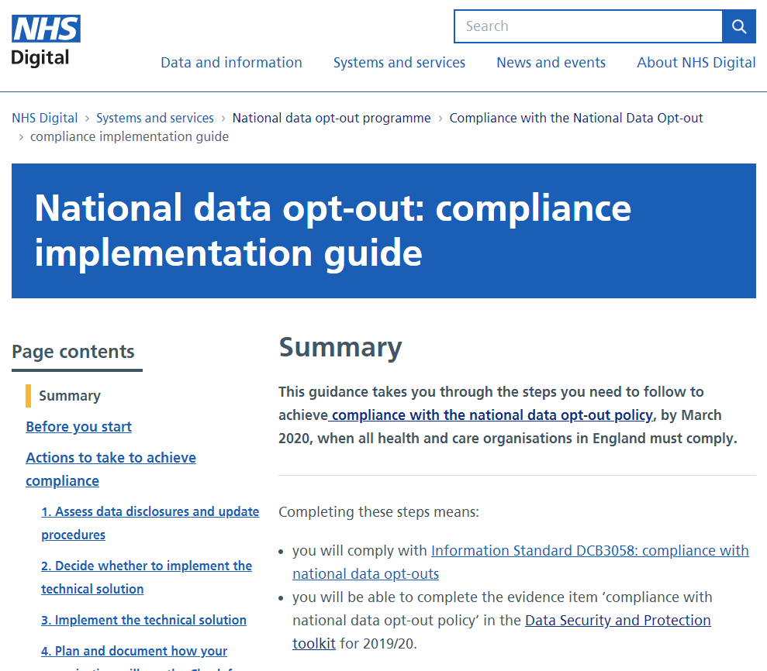
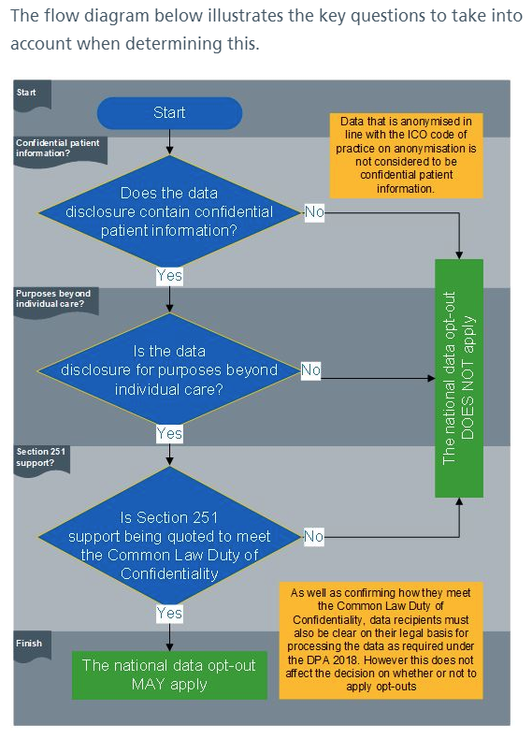
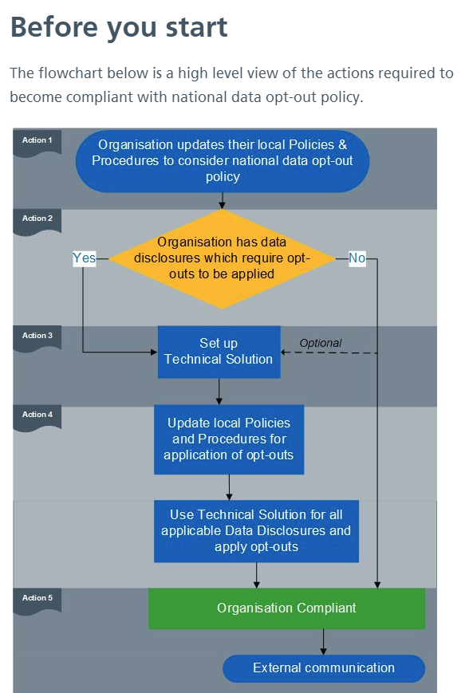
Information correct as of April 2019
Notes:
Screenshots to show CIG … and flowcharts.

Slide 31
Further information
For more information, workforce and patient resources go to:
https://digital.nhs.uk/national-data-opt-out
To contact us about becoming compliant or any other enquires, email: newoptoutenquiries@nhs.net
The ‘Your Data Matters to the NHS’ patient-facing service can be found at:
www.nhs.uk/your-nhs-data-matters
Information correct as of July 2019
Notes:
Extra links, depending on audience
Understanding Patient Data - Wellcome Trust
https://understandingpatientdata.org.uk
Information Governance Alliance (IGA) information on GDPR:
https://digital.nhs.uk/information-governance-alliance/General-Data-Protection-Regulation-guidance
RCGP Patient Data Choices - resources for GP practices
Toolkit: http://www.rcgp.org.uk/patientdatachoices
E-learning: http://elearning.rcgp.org.uk/course/info.php?id=156

